Slide 1
Falmouth Fire-EMS
Presentation to town council
January 27, 2020

Slide 2
FALMOUTH FIRE-EMS
Over its 107-year history, Falmouth Fire-EMS has evolved from 5 all-volunteer fire companies to a combination Fire-EMS department made up of six full-time staff (including one office administrator), thirty part-time per diem firefighter/paramedics and firefighter/EMTs, and sixty call firefighters and emergency medical technicians. Of the firefighters and EMTs nearly 1/3 of them reside outside Falmouth. The Department’s call volume and duties have also vastly expanded.
These changes in staffing structure, including decreased availability of call members, increased call volume, and expanded services have resulted in staffing challenges for the Department.

Slide 3
FALMOUTH FIRE-EMS
In July 2019, the Town issued an RFP for a study of current and future Falmouth Fire-EMS Department staffing needs. The goal of the study is to determine the adequacy of current staffing and future needs for full-time, per-diem members (part-time), and paid-on-call.
Town staff reviewed the four firms who submitted proposals and selected Criterion and Associates to conduct the study.
The Fire-EMS staffing study is expected to be submitted soon and staff is preparing to present it to the Town Council at their February 10, 2020 meeting.
In advance of that report, this presentation will review the Department’s current and past staffing structure and the related challenges facing the Department.

Slide 4
FALMOUTH FIRE-EMS
The challenges are broken into 5 categories:
Call Volume has Increased Significantly
Availability of Call Members has Decreased
Adequate Number of Members are Needed to Respond
EMS Protocols have changed
On-duty Staff Perform many other Important Duties

Slide 5
Call Volume has Increased significantly
Falmouth Fire-EMS
Incidents 2011-2019
Type of Incident | 2011 | 2012 | 2013 | 2014 | 2015 | 2016 | 2017 | 2018 | 2019
Building Fire | 6 | 10 | 13 | 14 | 13 | 8 | 11 | 8 | 6
Electrical Fire | 23 | 12 | 11 | 23 | 9 | 10 | 8 | 9 | 12
Chimney Fire | 5 | 1 | 3 | 5 | 11 | 0 | 1 | 5 | 2
Cooking Fire | 8 | 4 | 3 | 5 | 9 | 6 | 22 | 12 | 15
Fuel Boiler Malfunction | 5 | 2 | 1 | 5 | 7 | 2 | 11 | 6 | 7
Vehicle Fire | 6 | 9 | 8 | 7 | 8 | 8 | 10 | 9 | 3
Smoke Investigation | 44 | 24 | 35 | 47 | 50 | 35 | 36 | 41 | 21
Brush Fire | 21 | 16 | 15 | 26 | 25 | 11 | 23 | 5 | 19
Unauthorized Burning | 5 | 16 | 17 | 9 | 7 | 10 | 12 | 10 | 8
Power Lines Down | 41 | 39 | 16 | 28 | 14 | 50 | 39 | 32 | 35
Fire Alarm / Detector / Sprinkler Activation | 162 | 165 | 172 | 184 | 237 | 202 | 175 | 179 | 190
Carbon Monoxide Alarms | 28 | 21 | 26 | 30 | 32 | 31 | 33 | 25 | 23
Emergency Medical Services | 1022 | 967 | 1072 | 1063 | 1246 | 1181 | 1308 | 1254 | 1395
Motor Vehicle Crashes | 103 | 114 | 94 | 109 | 112 | 137 | 125 | 105 | 125
Rescue Other – Animal, Elevator, etc. | 5 | 2 | 3 | 6 | 6 | 5 | 16 | 12 | 12
Hazardous Materials – Fuel Spills & Leaks | 14 | 15 | 21 | 21 | 28 | 27 | 29 | 14 | 43
Assist Other Agency | 28 | 4 | 9 | 5 | 7 | 29 | 24 | 11 | 12
Good Intent Call / Public Assist | 41 | 15 | 5 | 11 | 6 | 15 | 8 | 10 | 17
False Alarm | 20 | 21 | 13 | 2 | 6 | 11 | 3 | 2 | 2
Cover Assignment | 21 | 42 | 24 | 34 | 29 | 30 | 21 | 20 | 24
Coverage at Sporting Events | * | 27 | 18 | 22 | 17 | 21 | 22 | 17 | 24
Weather Related | 9 | 4 | 11 | 21 | 7 | 11 | 4 | 7 | 12
Inspections – Occupancy, Woodstove, Fire Alarm, etc. | 20 | 19 | 3 | 6 | 3 | 6 | 23 | 3 | 74
Prevention – Pre-plans, Detector Installs, EMA, etc. | ** | ** | 34 | 113 | 82 | 43 | 55 | 23 | 135
Total Incidents | 1637 | 1549 | 1627 | 1796 | 1971 | 1889 | 2019 | 1819 | 2216
* Coverage for Sporting Events was not tracked until 2012.
** Fire Prevention Activities were not tracked until 2013.

Slide 6
Call volume has increased significantly
YEAR | FIRE CALLS | EMS CALLS | TOTAL CALLS
1959 | 91 | 0 | 91
1969 | 127 | 13 | 127
1979 | 210 | 400 | 610
1989 | 335 | 579 | 914
1999 | 494 | 688 | 1182
2009 | * | * | 1517
2019 | 821 | 1395 | 2216
Proj 2029** | 1133 | 1925 | 3058
Proj 2039** | 1564 | 2656 | 4220
* Note: From 2005 – 2010 EMS calls were not separated.
** Projected 2029 and 2039 assumes 38% growth

Slide 7
Call volume has increased significantly
Emergency Calls Per Apparatus
Apparatus | 2011 | 2019 | % Change
Ambulances | 1372 | 1858 | 35%
Engine 1 (Foreside Road) | 186 | 269 | 45%
Engine 2 (Bucknam Road) | 318 | 415 | 31%
Engine 4 (Winn Road) | 230 | 204 | (11%)
Tower 2 (Bucknam Road) | 175 | 183 | 5%
Tank 4 (Winn Road) | 71 | 64 | (10%)
Rescue 1 (Heavy Rescue) | 177 | N/A | (100%)
Utility 4 (1st Response - West Station) | N/A | 154 | N/A
Utility 5 (UTV) | N/A | 12 | N/A
Utility 6 (1st Response – Bucknam Road) | N/A | 99 | N/A
Average Response Time in Minutes (from time dispatched to time on scene):
Apparatus | 2017 | 2018 | 2019
First Due Ambulance | 6.86 | 6.59 | 7.20
Second Due Ambulance | 18.60 | 15.62 | 7.73
Engine 1 | 11.10 | 11.10 | 10.80
Engine 2 | 12.40 | 11.40 | 10.10
Engine 4 | 15.30 | 13.80 | 14.30
In December 2019 we responded to 162 calls including 29 concurrent calls.

Slide 8
Call volume has increased significantly
Apparatus that was Called to a Scene but did not Respond (did not have a driver and/or a crew)
Apparatus | Station | 2011 | 2019 | Change
Engine 1 | Foreside Road | 6% | 23% | 17%
Engine 2 | Bucknam Road | 4% | 10% | 6%
Tower 2 | Bucknam Road | 14% | 43% | 29%
Engine 4 | Winn Road | 7% | 11% | 4%
Tank 4 | Winn Road | 17% | 40% | 23%
* When one apparatus does not respond another one is dispatched. All calls are covered.

Slide 9
Call volume has increased significantly
Average Crew Size for Fire Apparatus 2011 versus 2019
 | 2011 |  | 2019
Apparatus | Calls | Avg. Crew | Calls | Avg. Crew
Engine 1 | 186 | 2.6 | 267 | 2.1
Engine 2 | 318 | 3.4 | 409 | 3.0
Tower 2 | 175 | 2.7 | 181 | 1.4
Engine 4 | 230 | 3.2 | 201 | 2.8
Tank 4 | 71 | 2.0 | 63 | 1.5

Slide 10
decrease in active call members
New Call Members Added
Year | New Call Members | Still Active as of 1/1 2020 | % Still Active
2010 | 14 | 2 | 14%
2011 | 23 | 2 | 9%
2012 | 12 | 1 | 8%
2013 | 15 | 2 | 13%
2014 | 17 | 2 | 12%
2015 | 12 | 1 | 8%
2016 | 8 | 2 | 25%
2017 | 16 | 3 | 19%
2018 | 10 | 6 | 60%
Number of different members volunteering to cover an EMS shift:
 | 2011 | 2019 | % Change
September | 22 | 10 | (45%)
October | 24 | 11 | (46%)
November | 23 | 10 | (43%)
Average Training Attendance:
Monday Night Department Training | 2011 | 2019 | Variance
Average Training Attendance | 47 | 30 | (36%)

Slide 11
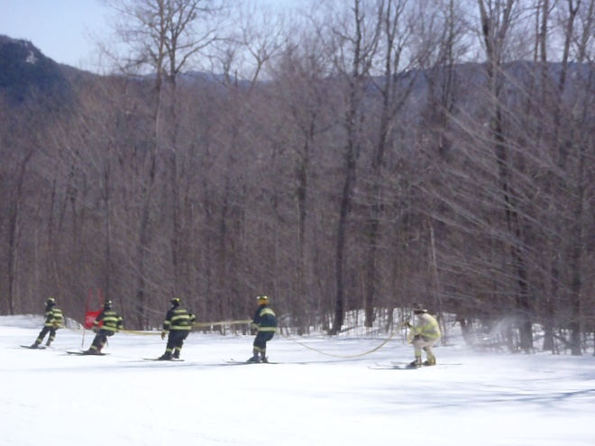
decrease in active call members
In past 10 years, 29 active FF/EMT have obtained new fulltime fire-ems job:
Biddeford, Bridgton, Brunswick (2), Buxton (2), Gardner, Lewiston (2), Old Town, Portland (3), Saco, Scarborough (2), South Portland (5), Westbrook (4), Brattleboro, VT, Nashua, NH, Seekonk, MA, Winooski, VT
Moved out of Town:
In past 5 years, we have had members move to:
California
Colorado
Connecticut
Hawaii
Indiana
Massachusetts
Michigan
New Hampshire
New York
Pennsylvania
Vermont
Others have stayed in Maine but moved too far away to respond:
Bangor
Bridgton
Lebanon
New Gloucester
Richmond
Saco
Topsham
Waterboro
Northern Maine
In the past 10 years, nine Volunteer EMTs have gone on to medical school!

Slide 12
decrease in active call members
Average Crew Size for All Calls:
In 2011 – 8707 people responded to 1637 incidents
Fulltime / Per Diem 1955 22%
Call Staff 6752 78%
In 2019 – 8514 people responded to 2216 incidents
Fulltime / Per Diem 5089 60%
Call Staff 3425 40%
That’s a 49% drop in call staff response and a 154% increase in paid staff response from 2011 to 2019.

Slide 13
decrease in active call members
Current FT employees cannot complete the jobs they were hired to do if always on calls:
EMA, EMS Supervision, Fire Prevention, Building Pre-plans, Life Safety Inspections, Truck Maintenance, etc.
The EMA and EMS/Prevention Captains have performed a combined 124 EMS Transports and responded to 238 Fire Calls in just 9 months (over 140 hours on EMS transports).
Officers filling lower operational positions. Staffing shortages that result in the fire chief driving the fire truck or fulfilling the responsibilities of other line firefighters is another sign of a serious staffing problem. (IAFC, Red Ribbon Report)
OSHA last month cited a Fire Department in Illinois for having a Fire Chief as the pump operator, during an incident that result in a FF death.

Slide 14
members are needed to respond
NFPA Staffing 2020 Edition
1720 – Combination: A fire department having emergency service personnel comprising less than 85 percent majority of either volunteer or career membership.
Based on a low-hazard occupancy such as a 2000sq. ft. two-story, single-family home without basement and exposures.
Falmouth Fire-EMS is a combination fire department (60% volunteer/call).
West of Middle Road – Rural <500 people/sq. mile (source: US Census)
NFPA 1720 recommends minimum of 6 personnel within 14 minutes
2011 – 52.5% of the time 2019 – 43.3% of the time
East of Middle Road – Suburban 500-1000 people/sq. mile (source: US Census)
NFPA 1720 recommends minimum of 10 personnel within 10 minutes
2011 – 4.3% of the time 2019 – 1.7% of the time

Slide 15
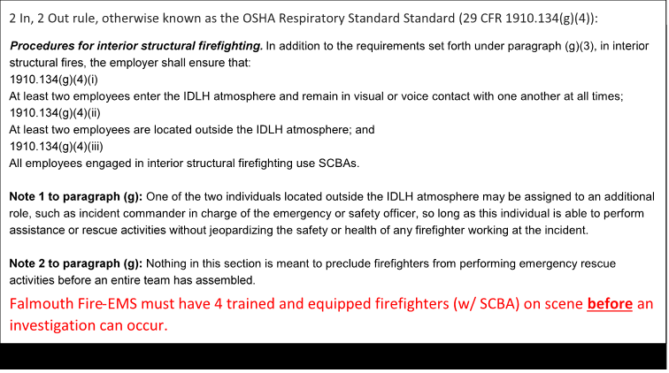
members are needed to respond

Slide 16
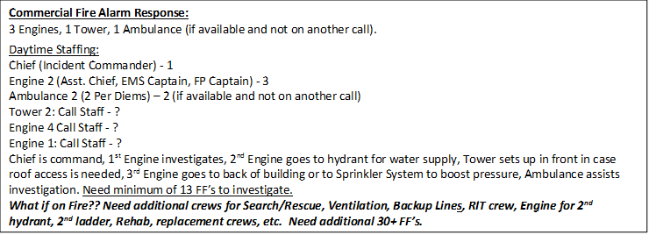
members are needed to respond

Slide 17
members are needed to respond
Average Crew Size for Non-EMS calls:
In 2011: 7.3 average members responded to 629 non-EMS calls
>10 members 144 times or 22.9% of the time
>20 members 18 times (high of 43 members)
- There were 36 Desk Boxes (reported fire or smoke) and 4 house fires in 2011
In 2019: 5.5 average members responded to 826 Non-EMS calls
>10 members 85 times or 10.3% of the time
>20 members 2 times (high of 26 members)
- There were 36 Desk Boxes and 1 house fire in 2019

Slide 18
Changes in ems protocols
Cardiac Arrests:
Early cardiac defibrillation and uninterrupted high-quality CPR has been shown to significantly increase the survivability of patients in Cardiac Arrest. To do this, we must perform CPR where the patient is found for a minimum of 20 minutes before deciding whether to transport them to the hospital.
Cardiac Catherization Lab Activation
Falmouth Fire-EMS personnel now can identify a ST Elevated Myocardial Infarctions (STEMI) in the field. This allows them to deliver patients suffering from Myocardial Infarctions (heart attacks) directly to the Cardiac Cath Lab at MMC, where they can receive immediate treatment drastically improving their medical outcomes.
Stroke: Direct to CT Program at Maine Medical Center
In 2019 our crews partnered with other services and Maine Medical Center to quickly identify a patient having a stroke and make a call in to the hospital to initiate a program where the patient will get a CT Scan within 25 minutes of arrival at the hospital. This allows for quicker treatment and better long-term prognosis of PT’s suffering from a Cerebral Vascular Accident.

Slide 19
Changes in ems protocols
EMS Supplies:
In the past 5 years Maine Medical Center and Mercy Hospital no longer supply area EMS services with disposable supplies such as oxygen masks, IV solution (saline), IV needles, tubing, etc. Falmouth Fire-EMS must purchase, stock and maintain our own supplies. Supplies are checked and monitored daily.
Over the past 3 years Falmouth Fire-EMS must purchase and maintain their own medication supplies. “Drug boxes” used to be maintained and replaced by the hospitals after calls. Now departments maintain their own “drug boxes”, which is done daily to keep track of expiration dates and supply levels.
Lift Assist Calls, Medical Alarm Calls, No-transports:
In 2019 our crews responded to a documented 87 calls where we only lifted a person up off a floor, up or down a set of stairs, into a bed, into a car for an appointment, etc. This does not include the calls where we are called for a lift assist and find the patient needs to be transported for injury. These range from residents who have temporary needs due to a surgery or illness, to those that live alone in their homes and need help often. There are other calls like Medical Alarms, where we respond and there is no patient found. These calls take time to investigate.

Slide 20
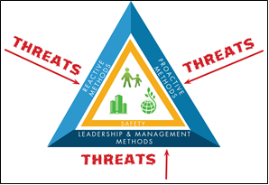
other important duties

Slide 21
other important duties
Other duties When not responding to calls:
Community Outreach:
We visit schools, daycares, senior housing, and others to promote fire and injury prevention, teach the use of fire extinguishers to staff, and perform emergency evacuation drills (visited 13 schools and over 800 kids).
We host a monthly car seat inspection station at Central Station with SafeKids Maine (200 seats).
We host 2 days for Fire-EMS at the Annual Summer Cop Camp held at Community Programs (30 kids/year).
Crews also visit businesses and private homes with Knox Box lock systems and with fire alarm systems to test for access and to test the alarms (125 tests in 2019).
Conduct Pre-plans of Buildings in Town (68 pre-plans in 2019).
Crew also conduct numerous CPR and 1st Aid classes both at the Fire Station and at various off-site locations including daycares, the high school, and private businesses.
Crews install Smoke and Combination Smoke & Carbon Monoxide Detectors in houses in Falmouth (over 1,000 Smoke and 700 CO detectors in past 5 years).

Slide 22
other important duties
In the past 5 years our staff has held various Membership Drives to Recruit Call Members:
At the Open House at Central Station every October
At the Volunteer Day put on by the Town at OceanView
At the annual SMCC Open House to promote our membership to Fire Science and Paramedicine students
At TD Bank
At Walmart during Fire Prevention Week
At the Homecoming Football Game each year when we volunteer to run the Snack Shack
At Foreside Station with a BBQ on Memorial Day. Also put an article in the Forecaster and in the Portland Press Herald.
At Winn Road Station in conjunction with Summit Gas informational meeting. Also put an add in the Forecaster and placed a “Help Wanted” sign board in front of Station 4.
At the Annual Easter Egg Hunt at the Church on Falmouth Road.

Slide 23
Staffing timeline
Year | Event | FT | PT (FTE) | Total FTE
1987 | First FT Fire Chief hired | 1 | 0 | 1.0
2002 | First FT EMS Provider hired | 2 | 0 | 2.0
2004 | Added PT daytime coverage (6 am to 6pm) of a paramedic | 2 | 2.2 | 4.2
2007 | FT Fire Chief Hired | 2 | 2.2 | 4.2
2008 | FT Office Administrator Position Added | 3 | 2.2 | 5.2
2008 | Added FT Assistant Chief position (Replaced full-time Deputy Chief of EMS) | 3 | 2.2 | 5.2
2009 | Pleasant Hill Fire Station (Station 3) closed | 3 | 2.2 | 5.2
2009 | Added PT nighttime coverage (7 pm to 7 am) of a per diem FF/Paramedic at Central Station | 3 | 4.4 | 7.4
2009 | Added $15/night stipend for overnight EMS volunteers to respond with overnight per diem | 3 | 4.4 | 7.4
2009 | Added 4 SMCC Live-in Students at West Station | 3 | 4.4 | 7.4

Slide 24
Staffing timeline
Year | Event | TF | PT (FTE) | Total FTE
2009 | 1st in-house Firefighter Level I and II class held – Graduated 33 members | 3 | 4.4 | 7.4
2010 | Started allowing call EMS members to live outside Falmouth (24 hours of coverage at Central). | 3 | 4.4 | 7.4
2010 | 1st in-house Fire Instructor I and II class held – Graduated 12 members | 3 | 4.4 | 7.4
2010 | Hired 3 PT EMA planners to work with senior housing, schools and daycares | 3 | 5 | 8.0
2010 | Put 3rd Ambulance in service (did not trade older ambulance) | 3 | 5 | 8.0
2011 | 1st in-house Fire Officer I and II class held – Graduated 24 members | 3 | 5 | 8.0
2013 | Increased overnight volunteer EMS stipend to $30/night | 3 | 5 | 8.0
2014 | Added daytime PT FF/EMT per diem position from 7 am to 7 pm | 3 | 7.2 | 10.2
2014 | Added 2 SMCC Live-in Students at Foreside Station | 3 | 7.2 | 10.2

Slide 25
Staffing timeline
Year | Event | FT | PT (FTE) | Total FTE
2015 | Added nighttime PT FF/EMT per diem position. From 7 pm to 7 am. | 3 | 9.4 | 12.4
2015 | Added FT Assistant Fire Chief position | 4 | 9.4 | 13.4
2016 | Overnight stipends added to pay weekend duty officers ($50/night) | 4 | 9.4 | 13.4
2017 | Held membership drive during home football game (repeated in 2018 & 2019) | 4 | 9.4 | 13.4
2017 | Added 2 PT per diem FF/EMS on Weekends and Holiday days from 8 am to 4 pm to cross-staff A3/E2 | 4 | 10.3 | 14.3
2017 | Started doing Pre-plans in the community | 4 | 10.3 | 14.3
2017 | Hosted Basic Fire Officer Class – Graduated 16 students (9 Falmouth Fire Officers) | 4 | 10.3 | 14.3
2018 | Labor Day membership drive at Foreside Station | 4 | 10.3 | 14.3

Slide 26
Staffing timeline
Year | Event | FT | PT (FTE) | Total FTE
2019 | Added FT EMA Captain position. The 3 former part-time EMA Planners no longer able to provide hours. EMA Captain to ramp up outreach in community through pre-plans and inspections. | 5 | 9.7 | 14.7
2019 | Added FT FF/EMT/Driver on Monday through Friday from 7 am to 4 pm. Focus is operating Engine 2 and Ambulance 3. While not on calls this position performs equipment and station maintenance and helps coordinate truck maintenance. | 6 | 9.7 | 15.7
2019 | Membership drive at West Station. | 6 | 9.7 | 15.7
2019 | Hosted Advanced Fire Officer Class – Graduated 16 students (4 Falmouth Fire Officers) | 6 | 9.7 | 15.7
2019 | Awarded bid to produce staffing study to Criterion Associates to help understand staffing needs, station placements, and project future staffing needs for next 20 years. | 6 | 9.7 | 15.7

Slide 27
Questions?
Thank you,
Chief Howard Rice, Jr.
8 Bucknam Road
Falmouth, ME 04105
hrice@falmouthme.org
(207) 781-2610

