Slide 1
Falmouth Fire-EMS
Public FORUM
February 24, 2020

Slide 2
FALMOUTH FIRE-EMS
Over its 107-year history, Falmouth Fire-EMS has evolved from 5 all-volunteer fire companies to a combination Fire-EMS department made up of six full-time staff (including one office administrator), thirty part-time per diem firefighter/paramedics and firefighter/EMTs, and sixty call firefighters and emergency medical technicians. Of the firefighters and EMTs nearly 1/3 of them reside outside Falmouth. The Department’s call volume and duties have also vastly expanded.
In July 2019, the Town issued an RFP for a study of current and future Falmouth Fire-EMS Department staffing needs. The goal of the study is to determine the adequacy of current staffing and future needs for full-time, per-diem members (part-time), and paid-on-call.

Slide 3
Staffing timeline
Year | Event | FT | PT (FTE) | Total FTE
1987 | First FT Fire Chief hired | 1 | 0 | 1.0
2002 | First FT EMS Provider hired | 2 | 0 | 2.0
2004 | Added PT daytime coverage (6 am to 6pm) of a paramedic | 2 | 2.2 | 4.2
2007 | FT Fire Chief Hired | 2 | 2.2 | 4.2
2008 | FT Office Administrator Position Added | 3 | 2.2 | 5.2
2008 | Added FT Assistant Chief position (Replaced full-time Deputy Chief of EMS) | 3 | 2.2 | 5.2
2009 | Pleasant Hill Fire Station (Station 3) closed | 3 | 2.2 | 5.2
2009 | Added PT nighttime coverage (7 pm to 7 am) of a per diem FF/Paramedic at Central Station | 3 | 4.4 | 7.4
2009 | Added $15/night stipend for overnight EMS volunteers to respond with overnight per diem | 3 | 4.4 | 7.4
2009 | Added 4 SMCC Live-in Students at West Station | 3 | 4.4 | 7.4

Slide 4
Staffing timeline
Year | Event | TF | PT (FTE) | Total FTE
2009 | 1st in-house Firefighter Level I and II class held – Graduated 33 members | 3 | 4.4 | 7.4
2010 | Started allowing call EMS members to live outside Falmouth (24 hours of coverage at Central). | 3 | 4.4 | 7.4
2010 | 1st in-house Fire Instructor I and II class held – Graduated 12 members | 3 | 4.4 | 7.4
2010 | Hired 3 PT EMA planners to work with senior housing, schools and daycares | 3 | 5 | 8.0
2010 | Put 3rd Ambulance in service (did not trade older ambulance) | 3 | 5 | 8.0
2011 | 1st in-house Fire Officer I and II class held – Graduated 24 members | 3 | 5 | 8.0
2013 | Increased overnight volunteer EMS stipend to $30/night | 3 | 5 | 8.0
2014 | Added daytime PT FF/EMT per diem position from 7 am to 7 pm | 3 | 7.2 | 10.2
2014 | Added 2 SMCC Live-in Students at Foreside Station | 3 | 7.2 | 10.2

Slide 5
Staffing timeline
Year | Event | FT | PT (FTE) | Total FTE
2015 | Added nighttime PT FF/EMT per diem position. From 7 pm to 7 am. | 3 | 9.4 | 12.4
2015 | Added FT Assistant Fire Chief position | 4 | 9.4 | 13.4
2016 | Overnight stipends added to pay weekend duty officers ($50/night) | 4 | 9.4 | 13.4
2017 | Held membership drive during home football game (repeated in 2018 & 2019) | 4 | 9.4 | 13.4
2017 | Added 2 PT per diem FF/EMS on Weekends and Holiday days from 8 am to 4 pm to cross-staff A3/E2 | 4 | 10.3 | 14.3
2017 | Started doing Pre-plans in the community | 4 | 10.3 | 14.3
2017 | Hosted Basic Fire Officer Class – Graduated 16 students (9 Falmouth Fire Officers) | 4 | 10.3 | 14.3
2018 | Labor Day membership drive at Foreside Station | 4 | 10.3 | 14.3

Slide 6
Staffing timeline
Year | Event | FT | PT (FTE) | Total FTE
2019 | Added FT EMA Captain position. The 3 part-time EMA Planners no longer able to provide hours. EMA Captain to ramp up outreach in community through pre-plans and inspections. | 5 | 9.7 | 14.7
2019 | Added FT FF/EMT/Driver on Monday through Friday from 7 am to 4 pm. Focus is operating Engine 2 and Ambulance 3. While not on calls this position performs equipment and station maintenance and helps coordinate truck maintenance. | 6 | 9.7 | 15.7
2019 | Membership drive at West Station. | 6 | 9.7 | 15.7
2019 | Hosted Advanced Fire Officer Class – Graduated 16 students (4 Falmouth Fire Officers) | 6 | 9.7 | 15.7
2019 | Awarded bid to produce staffing study to Criterion Associates to help understand staffing needs, station placements, and project future staffing needs for next 20 years. | 6 | 9.7 | 15.7

Slide 7
FALMOUTH FIRE-EMS
The challenges are divided into 5 categories:
Call Volume has Increased Significantly
Availability of Call Members has Decreased
Adequate Number of Members are Needed to Respond
EMS Protocols have changed
On-duty Staff Perform many other Important Duties

Slide 8
Call Volume has Increased significantly
Falmouth Fire-EMS
Incidents 2011-2019
Type of Incident | 2011 | 2012 | 2013 | 2014 | 2015 | 2016 | 2017 | 2018 | 2019
Building Fire | 6 | 10 | 13 | 14 | 13 | 8 | 11 | 8 | 6
Electrical Fire | 23 | 12 | 11 | 23 | 9 | 10 | 8 | 9 | 12
Chimney Fire | 5 | 1 | 3 | 5 | 11 | 0 | 1 | 5 | 2
Cooking Fire | 8 | 4 | 3 | 5 | 9 | 6 | 22 | 12 | 15
Fuel Boiler Malfunction | 5 | 2 | 1 | 5 | 7 | 2 | 11 | 6 | 7
Vehicle Fire | 6 | 9 | 8 | 7 | 8 | 8 | 10 | 9 | 3
Smoke Investigation | 44 | 24 | 35 | 47 | 50 | 35 | 36 | 41 | 21
Brush Fire | 21 | 16 | 15 | 26 | 25 | 11 | 23 | 5 | 19
Unauthorized Burning | 5 | 16 | 17 | 9 | 7 | 10 | 12 | 10 | 8
Power Lines Down | 41 | 39 | 16 | 28 | 14 | 50 | 39 | 32 | 35
Fire Alarm / Detector / Sprinkler Activation | 162 | 165 | 172 | 184 | 237 | 202 | 175 | 179 | 190
Carbon Monoxide Alarms | 28 | 21 | 26 | 30 | 32 | 31 | 33 | 25 | 23
Emergency Medical Services | 1022 | 967 | 1072 | 1063 | 1246 | 1181 | 1308 | 1254 | 1395
Motor Vehicle Crashes | 103 | 114 | 94 | 109 | 112 | 137 | 125 | 105 | 125
Rescue Other – Animal, Elevator, etc. | 5 | 2 | 3 | 6 | 6 | 5 | 16 | 12 | 12
Hazardous Materials – Fuel Spills & Leaks | 14 | 15 | 21 | 21 | 28 | 27 | 29 | 14 | 43
Assist Other Agency | 28 | 4 | 9 | 5 | 7 | 29 | 24 | 11 | 12
Good Intent Call / Public Assist | 41 | 15 | 5 | 11 | 6 | 15 | 8 | 10 | 17
False Alarm | 20 | 21 | 13 | 2 | 6 | 11 | 3 | 2 | 2
Cover Assignment | 21 | 42 | 24 | 34 | 29 | 30 | 21 | 20 | 24
Coverage at Sporting Events | * | 27 | 18 | 22 | 17 | 21 | 22 | 17 | 24
Weather Related | 9 | 4 | 11 | 21 | 7 | 11 | 4 | 7 | 12
Inspections – Occupancy, Woodstove, Fire Alarm, etc. | 20 | 19 | 3 | 6 | 3 | 6 | 23 | 3 | 74
Prevention – Pre-plans, Detector Installs, EMA, etc. | ** | ** | 34 | 113 | 82 | 43 | 55 | 23 | 135
Total Incidents | 1637 | 1549 | 1627 | 1796 | 1971 | 1889 | 2019 | 1819 | 2216
* Coverage for Sporting Events was not tracked until 2012.
** Fire Prevention Activities were not tracked until 2013.

Slide 9
Call volume has increased significantly
Apparatus that was Called to a Scene but did not Respond (did not have a driver and/or a crew)
Apparatus | Station | 2011 | 2019 | Change
Engine 1 | Foreside Road | 6% | 23% | 17%
Engine 2 | Bucknam Road | 4% | 10% | 6%
Tower 2 | Bucknam Road | 14% | 43% | 29%
Engine 4 | Winn Road | 7% | 11% | 4%
Tank 4 | Winn Road | 17% | 40% | 23%
* When one apparatus does not respond another one is dispatched. All calls are covered.

Slide 10
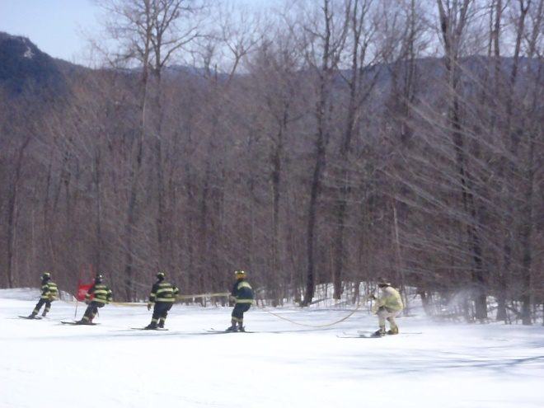
decrease in active call members
In past 10 years, 29 active FF/EMT have obtained new fulltime fire-ems job:
Biddeford, Bridgton, Brunswick (2), Buxton (2), Gardner, Lewiston (2), Old Town, Portland (3), Saco, Scarborough (2), South Portland (5), Westbrook (4), Brattleboro, VT, Nashua, NH, Seekonk, MA, Winooski, VT
Moved out of Town:
In past 5 years, we have had members move to:
California
Colorado
Connecticut
Hawaii
Indiana
Massachusetts
Michigan
New Hampshire
New York
Pennsylvania
Vermont
Others have stayed in Maine but moved too far away to respond:
Bangor
Bridgton
Lebanon
New Gloucester
Richmond
Saco
Topsham
Waterboro
Northern Maine
Now it is up to 30!
In the past 10 years, nine Volunteer EMTs have gone on to medical school!

Slide 11
decrease in active call members
Average Crew Size for All Calls:
In 2011 – 8,707 people responded to 1,637 incidents
Fulltime / Per Diem 1955 22%
Call Staff 6752 78%
In 2019 – 8,514 people responded to 2,216 incidents
Fulltime / Per Diem 5089 60%
Call Staff 3425 40%
That’s a 49% drop in call staff response and a 154% increase in paid staff response from 2011 to 2019.

Slide 12
members are needed to respond
NFPA 1720 Staffing Guideline for Combination Departments
Falmouth Fire-EMS is a combination fire department (60% volunteer/call).
West of Middle Road – Rural <500 people/sq. mile (source: US Census)
NFPA 1720 recommends minimum of 6 personnel within 14 minutes
2011 – 52.5% of the time 2019 – 43.3% of the time
East of Middle Road – Suburban 500-1000 people/sq. mile (source: US Census)
NFPA 1720 recommends minimum of 10 personnel within 10 minutes
2011 – 4.3% of the time 2019 – 1.7% of the time
OSHA 2-In 2-Out Regulation
At least two employees enter the Immediately Dangerous to Life or Health (IDLH) atmosphere and remain in visual or voice contact with each other at all times.
At least two employees are located outside the IDLH atmosphere to assure that the "two in" can monitor each other and assist with equipment failure or entrapment or other hazards, and the "two out" can monitor those in the building, initiate rescue, or call for back-up. One of the "two out" can be assigned another role such as incident commander.
Falmouth Fire-EMS must have 4 trained and equipped firefighters on scene (w/ SCBA) before an investigation can occur.

Slide 13
Changes in ems protocols
Recent upgrades to EMS in our area:
CPR – Crews must now perform CPR where the patient is found for a minimum of 20 minutes before deciding whether to transport them to the hospital.
Cardiac Catherization Lab Activation – Crews can now identify a ST Elevated Myocardial Infarctions (STEMI) in the field. This allows them to deliver patients suffering from Myocardial Infarctions (heart attacks) directly to the Cardiac Cath Lab at MMC, where they can receive immediate treatment drastically improving their medical outcomes.
Stroke: Direct to CT Program at Maine Medical Center – Crews can now quickly identify a patient having a stroke and make a call in to the hospital to initiate a program where the patient will get a CT Scan within 25 minutes of arrival at the hospital. This allows for quicker treatment and better long-term prognosis of PT’s suffering from a Cerebral Vascular Accident.
EMS Supplies - Falmouth Fire-EMS must now purchase, stock, maintain, and monitor our own supplies daily.
Lift Assists - In 2019 our crews responded to 87 calls where we lifted a person up off a floor, up or down a set of stairs, into a bed, into a car for an appointment, etc.

Slide 14
other important duties
Other duties when not responding to calls:
Community Outreach:
We visit schools, daycares, senior housing, and others to promote fire and injury prevention, teach the use of fire extinguishers to staff, and perform emergency evacuation drills (visited 13 schools and over 800 kids).
We host a monthly car seat inspection station at Central Station with SafeKids Maine (200 seats).
We host 2 days for Fire-EMS at the Annual Summer Cop Camp held at Community Programs (30 kids/year).
Crews also visit businesses and private homes with Knox Box lock systems and with fire alarm systems to test for access and to test the alarms (125 tests in 2019).
Conduct Pre-plans of Buildings in Town (68 pre-plans in 2019).
Crew also conduct numerous CPR and 1st Aid classes both at the Fire Station and at various off-site locations including daycares, the high school, and private businesses.
Crews install Smoke and Combination Smoke & Carbon Monoxide Detectors in houses in Falmouth (over 1,000 Smoke and 700 CO detectors in past 5 years).

Slide 15
Falmouth Fire-EMS Should Be Able to…
Handle Several EMS Calls
Handle EMS Call and a MVA
Respond to a Fire or Other Labor-Intensive Incident
Be a Good Neighbor so Mutual Aid Works in Both Directions
And also…
Meet the Expectations Set by Town Management, Policy Makers, Residents, and Visitors
Keep Up With Changing Expectations for Services

Slide 16
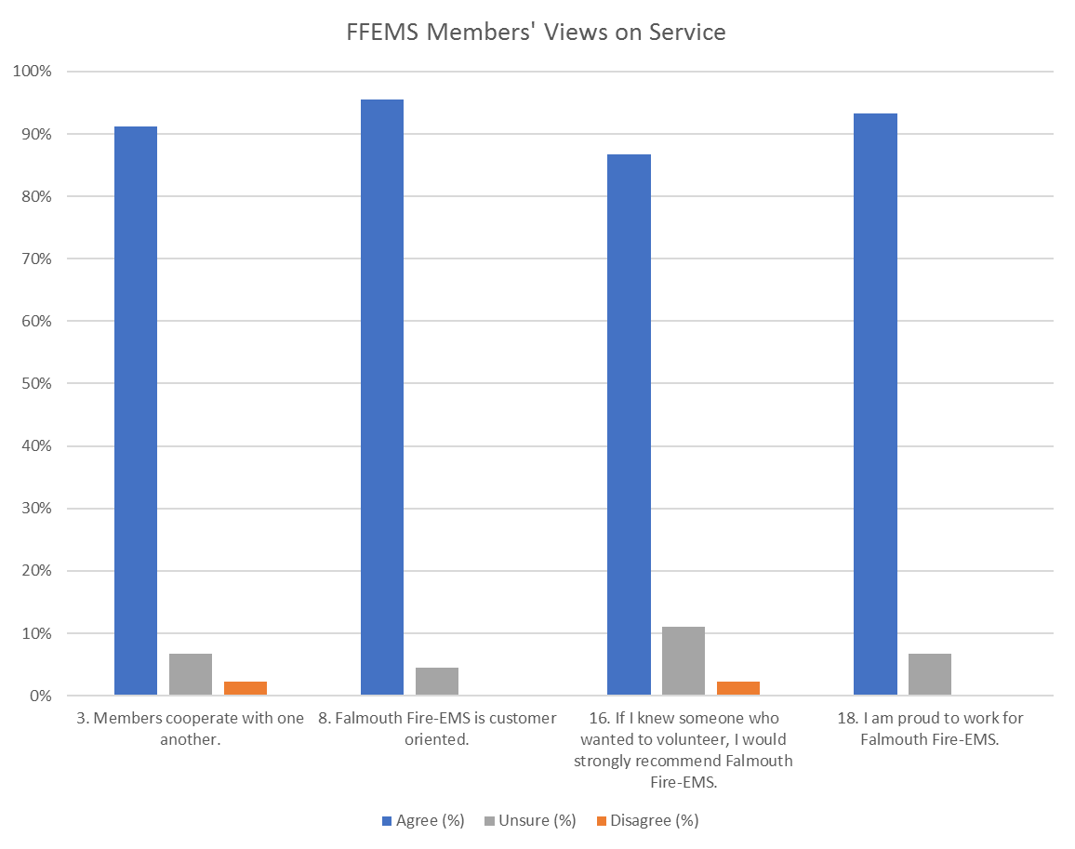
FALMOUTH FIRE-EMS

Slide 17
Survey – Why members say they are not responding to calls

Slide 18
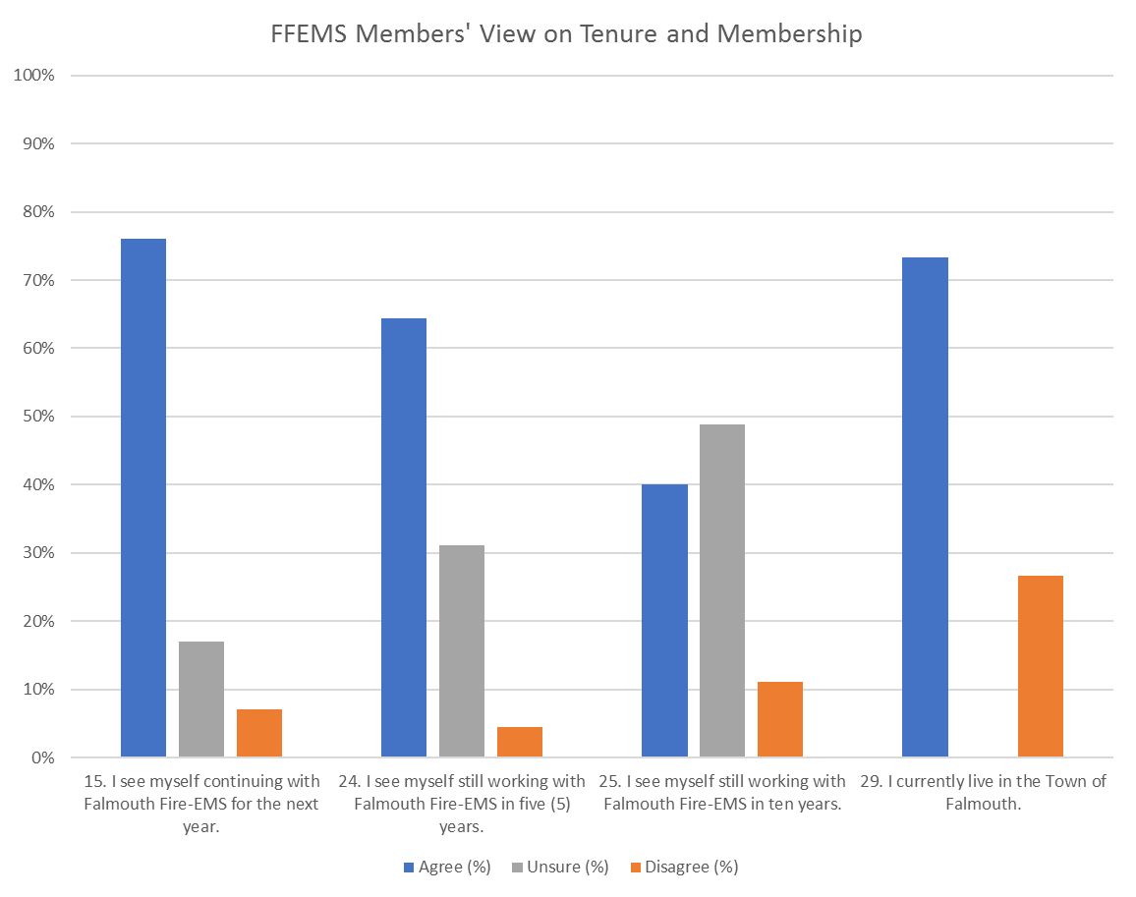
FALMOUTH FIRE-EMS

Slide 19
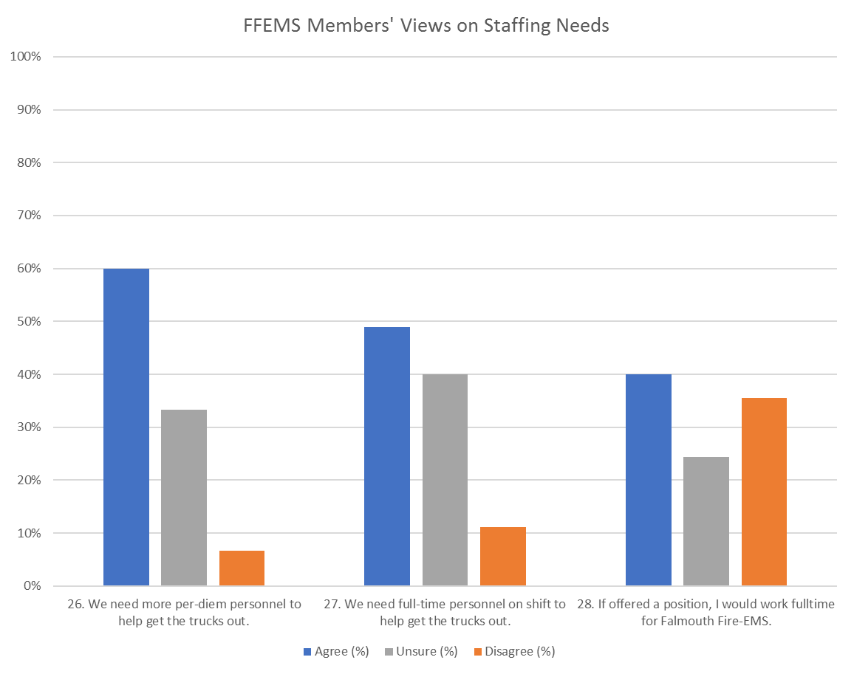
FALMOUTH FIRE-EMS

Slide 20
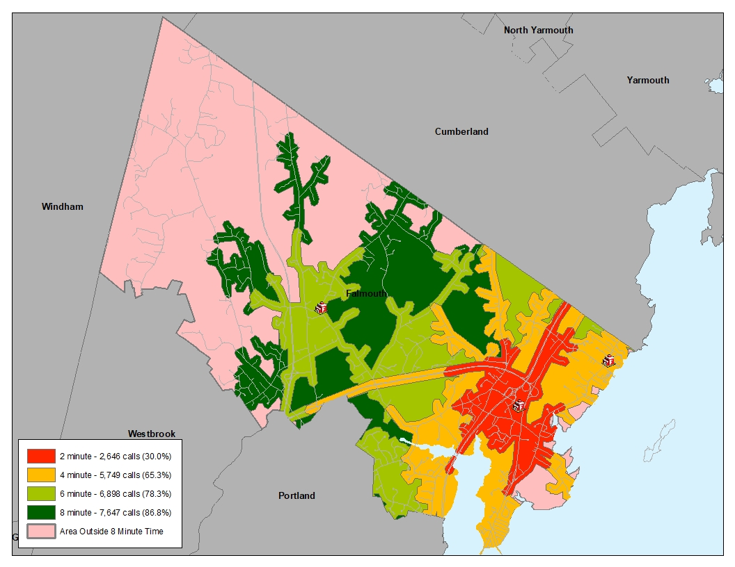
STAFFING AT CENTRAL (BUCKNAM ROAD) ONLY

Slide 21
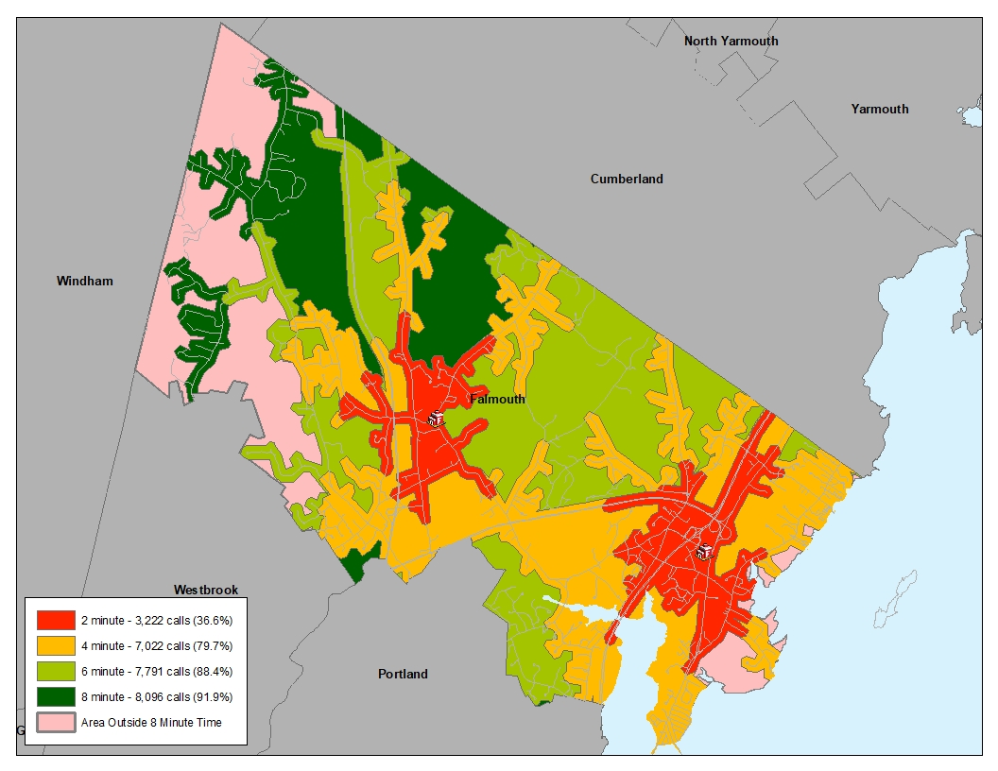
STAFFING AT CENTRAL AND WINN ROAD (STATION 4)

Slide 22
Staffing Plan for the Fire-EMS Department
Target Staffing of 13 on Shift in Five Years
HQ: Optimal = 8
Engine @ 3 (1 Lt. / 2 FF)
Ambulance @ 2 (2 FF)
Tower / Ambulance @ 2
Shift Commander @ 1
Sub-Station: Optimal = 5
Engine @ 3 (1 Lt. / 2 FF)
Ambulance @ 2 (2 FF)
Paramedics: @ 4 (2 in each station on the primary ambulance and on each engine)
Staffing With 13 Will Require 15 on Shift: 1 BC, 2 Lt., 12 FF’s (5 of Whom Are Paramedics)

Slide 23
Staffing plan
PHASE 1 – FY2021
Addition of 14 Fulltime FF/EMS at Central Station (Bucknam Road)
12 Fulltime FF/EMS working 3 people on duty at a time
2 Fulltime FF/EMS to float / cover vacancies
Addition of 2 Per Diem FF/EMS at Station 4 (Winn Road)
2 Per-Diem FF/EMS (Engine 4) – Daytime Only (7 am to 7 pm)
Night-time no change to current call staff-only coverage

Slide 24
Staffing PLAN
PHASE 2 – FY202?
Addition of 12 Fulltime FF/EMS at Station 4 (Winn Road)
12 Fulltime FF/EMS working 3 people on duty at a time
Potential use of Regional Response for Fire & EMS Calls
Falmouth Fire-EMS will use data and analysis to determine if future increases are needed to staff apparatus. This will be determined by the future response of call staff. Discussions with neighboring departments may develop future enhanced regional partnerships.

Slide 25
Staffing plan budget
PHASE 1 – FY2021
Fire-EMS Expansion – Addition of 14 FTEs
Salaries 595,680
Per Diem Coverage 306,628
OT to cover FT call-outs, vacation, etc. 50,000
Benefits 317,296
Recruiting Costs 10,000
Computer Licenses 2,500
Uniforms 15,000
New Gear, Radios, Pagers 75,000
Total Operating Expense Increase $1,372,104

Slide 26
Staffing plan budget
FY2022
Fire-EMS Expansion (Year 2)
Salaries 770,880
Per Diem Coverage 192,748
OT to cover FT call-outs, vacation, etc. 50,000
Benefits 444,000
Recruiting Costs 0
Computer Licenses 0
Uniforms 7,500
New Gear, Radios, Pagers 0
Total Operating Expense Increase $1,465,128
* Salary is excluding COLA or Benefit cost increases in FY2022

Slide 27
Questions?
Thank you,
Chief Howard Rice, Jr.
8 Bucknam Road
Falmouth, ME 04105
hrice@falmouthme.org
(207) 781-2610

